Slide 1
Cloud Models
Classification

Slide 2
Cloud Computing Models
Cloud computing services are categorized into three major models:
Platform as a Service (PaaS)
Software as a Service (SaaS)
Infrastructure as a Service (IaaS)

Slide 3
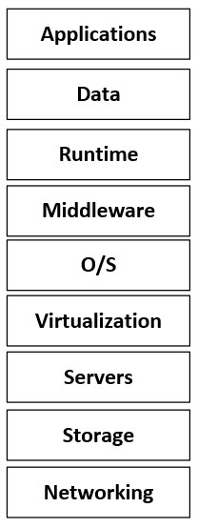
Cloud Layered Model
This is the Reference Layer Model for Cloud.
It represents the major conceptual components needed to provide any compute service.
From the bottom up, there is a physical infrastructure where the software runs.
Locations, energy, datacentres, servers, network equipment, etc.
The cloud is created by the virtualization of resources on top of this physical infrastructure.
That requires hypervisors. A hypervisor creates and runs virtual machines or any kind of virtual resource in general.
VM
VM
VM
Virtual
Infrastructure
Physical Infrastructure

Slide 4
Cloud Layered Model
Customer end use
The cloud supports many software processes:
Multiple Operating Systems. (typically, all of them).
Middleware which is the generic named given to the software that provides services to applications. This middleware does not come with the operating system by default.
The runtime is fundamentally the execution the computer programs and the environmental resources that it takes to run.
Finally, the model is completed by the customer applications and the associated data.
Software
Infrastructure
Virtual and Physical Infrastructure
Physical Infrastructure

Slide 5
Cloud Layered Model
This is a model that represents Cloud Offering types.
Clouds are classified depending on the level of access that the customers get to these layers.
The cloud provider provisions from the bottom to the top.
The customer have access from the top to a layer boundary that depends on the cloud type.
This demarcation point between the customer access and the cloud provider indicates the type of cloud.

Slide 6
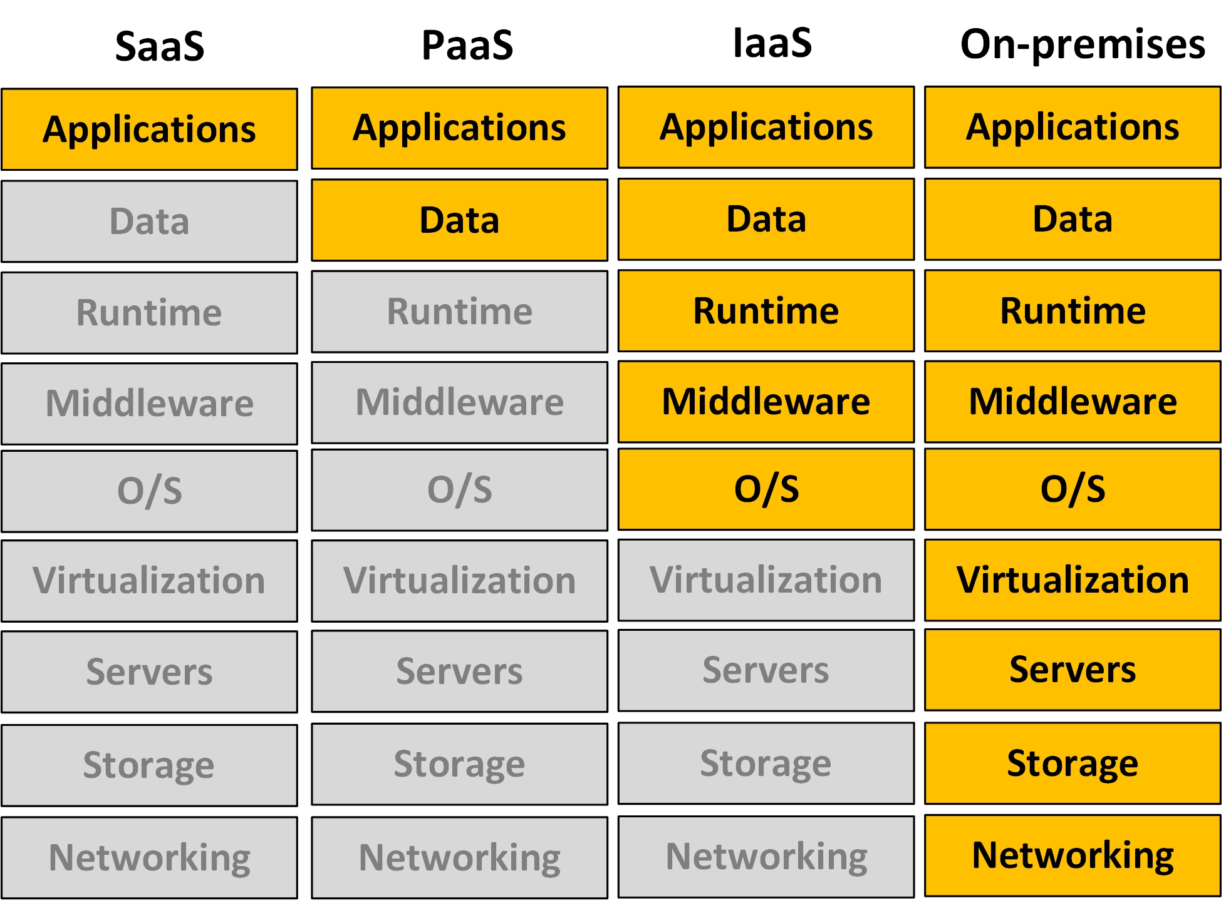
Cloud service offerings
Software as a service.
Platform as a Service.
Infrastructure as a Service.
On premises
Managed by the customer.
Managed by the cloud provider.

Slide 7
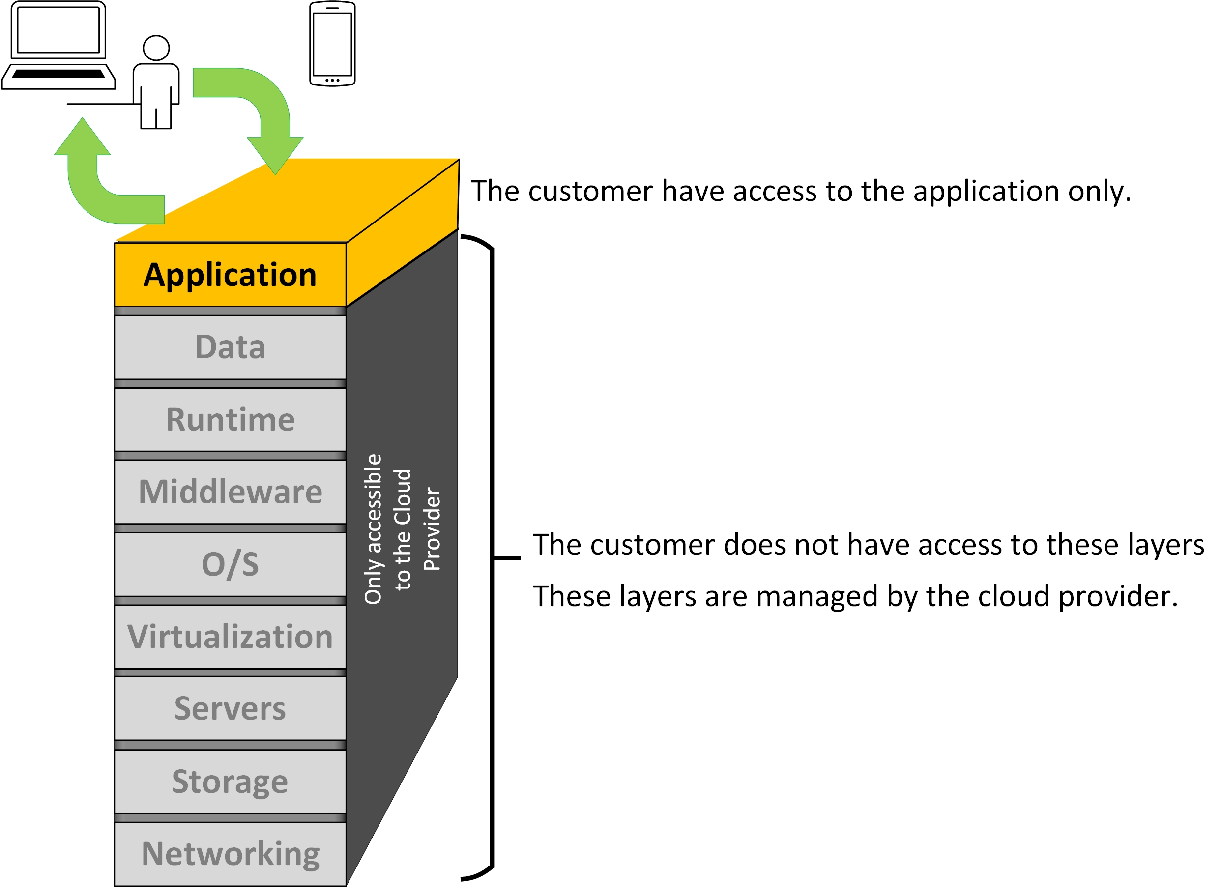
Software as a Service
SaaS

Slide 8
Software as a Service SaaS
The model objective is to deliver applications from a cloud.
The SaaS cloud provider provides an application ready to use.
The applications are managed by the cloud vendors.
The client purchases the use of the application on a subscription.
The application allows for some level of customization.
Many of these apps run via web protocols. All that the customer needs is to have access to a web browser.
Typically, there is no need to install anything on the client side.

Slide 9
Software as a Service (SaaS) examples
Microsoft Office 365
Google Gmail
Google Workspace
Salesforce
Cisco WebEx
Zoom
Teams
Dropbox
D2L SLATE

Slide 10
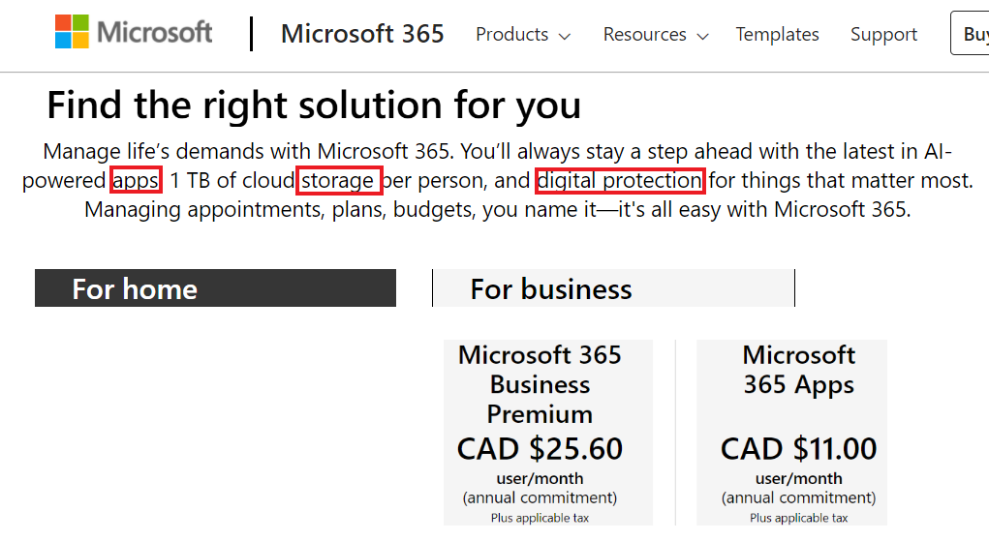
Software as a Service (SaaS) Microsoft 365)
License management and software installation have been cumbersome and nightmarish processes for IT organizations for decades.
Eventually, Microsoft found the solution.
Just place the applications, on demand, in the cloud.
Microsoft 365 provides application and secure storage for a subscription fee per user.

Slide 11
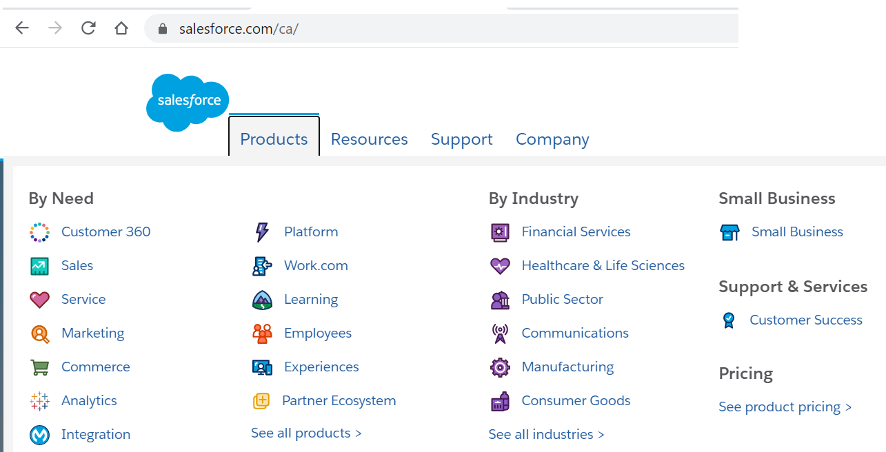
Software as a Service example (salesforce)
Salesforce offers SaaS for anything related with business administration.
The customer pays for the applications instead of developing and maintaining its own.
For example, a human resource system.

Slide 12
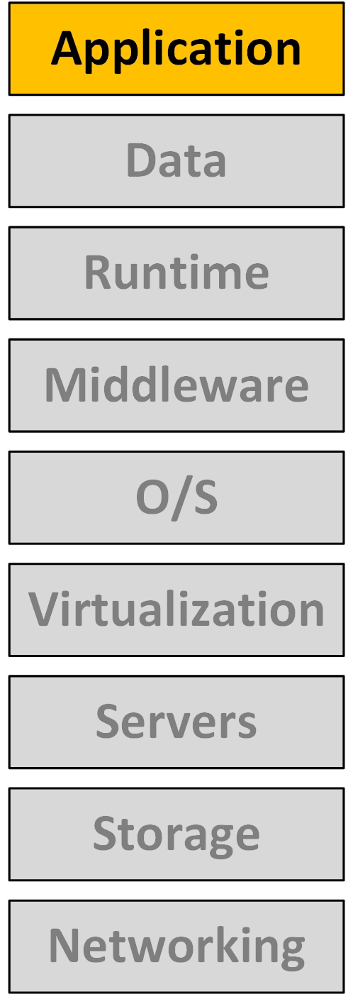
Software as a Service SaaS
Software as a Service is an application ready to be used.
The application is resident in a Cloud.
From the viewpoint of the customer is just some software running that provides some service.
This model is attractive to an organization the requires a turnkey solution for a problem.
An example of that is how Colleges use D2L SLATE.
Rather than developing their own web educational system, the Colleges pay for an already existing service.

Slide 13
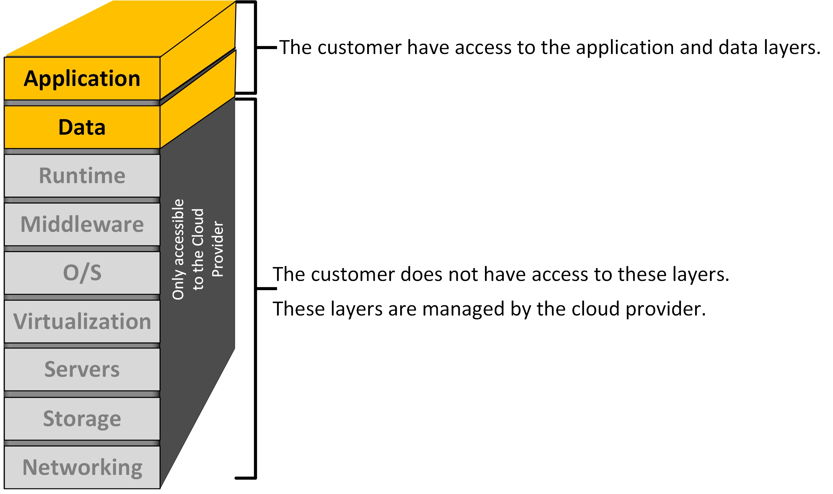
Platform as a Service
PaaS

Slide 14
Platform as a Service (PaaS)
Platform as a Service PaaS provides a complete development and deployment cloud environment (a platform) ready to be used.
This cloud computing mode presents an interface to the customer (an application developer, for example).
The interface hides the details of the platform.

Slide 15
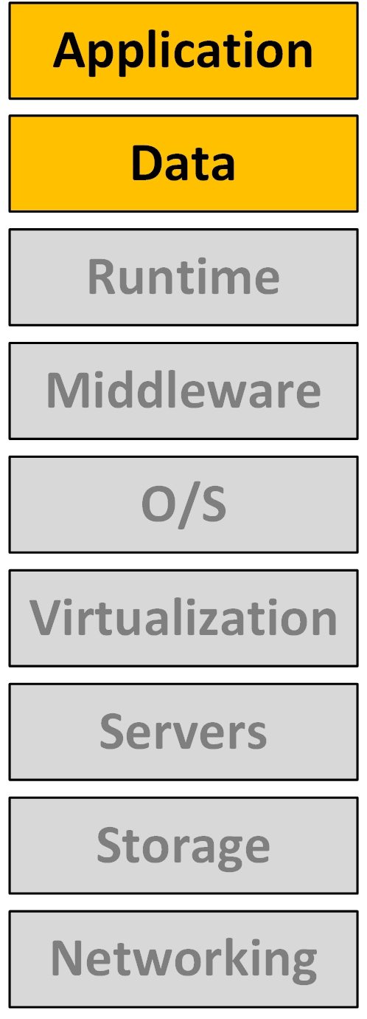
Platform as a Service (PaaS)
This cloud computing mode presents an interface to the customer (a system developer, for example).
The cloud layered model shows the demarcation point between the data and runtime.
This platform is an environment created and maintained by the service provider.
The platform comprehends all the gray layers. The cloud provider manages these layers. The client has no access to those.
The customer deals with an abstraction of the infrastructure.
The infrastructure is opaque to the customer.
The customer have access to the application and the data layers only. The customer manages these layers.

Slide 16
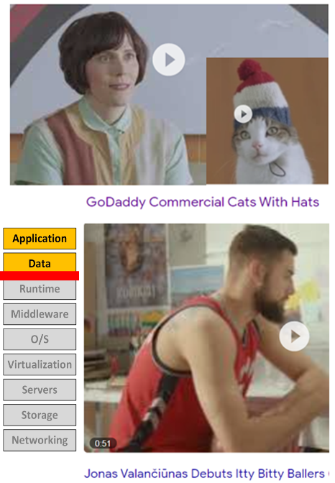
PaaS example, GoDaddy.com
The clients just want to sell a product using a website (hats for cats or JV’s basketball figures)
The customers do not care about the technical details of how to set up a webserver and a database to sell their products.
The PaaS provides the interface to enter the data to customize the features of the website.
Whatever happens in the backend is all opaque to the customer.
In reality, there is a data centre with virtual machines, containers, functions, webservers, database, security access, licenses and other factors involved.
All of that is taken care by the PaaS cloud provider.

Slide 17
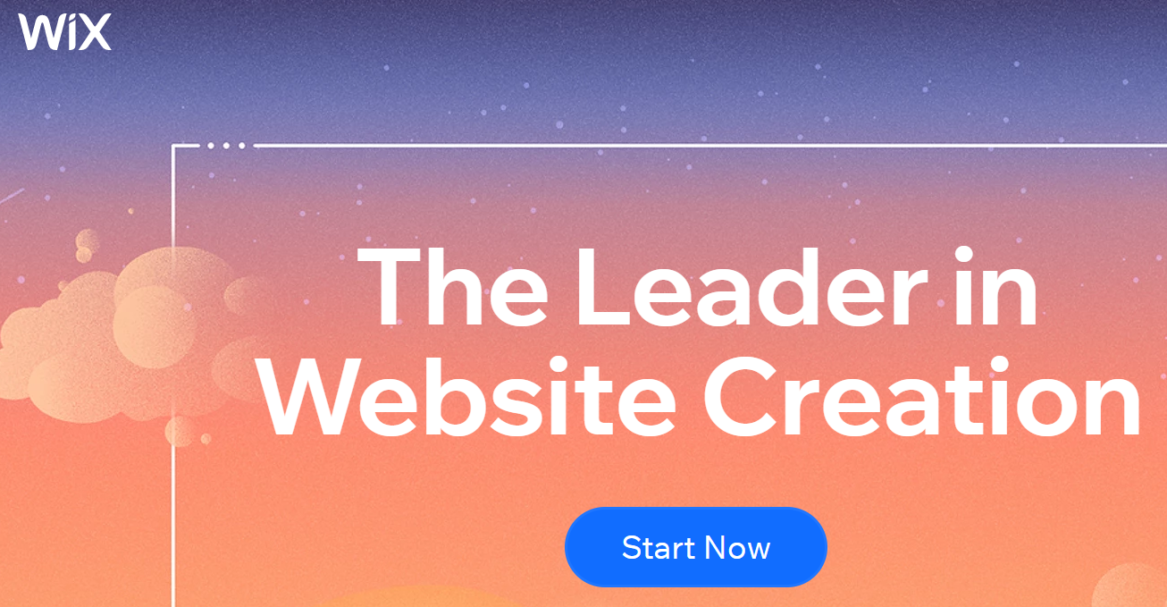
PaaS example, wix.com
Wix is another case of PaaS.
The customer can choose from many web site templates that Wix provides.
The customer customizes the looks of its website, unaware of how it is deployed in the platform.
The customer does not care about it.

Slide 18
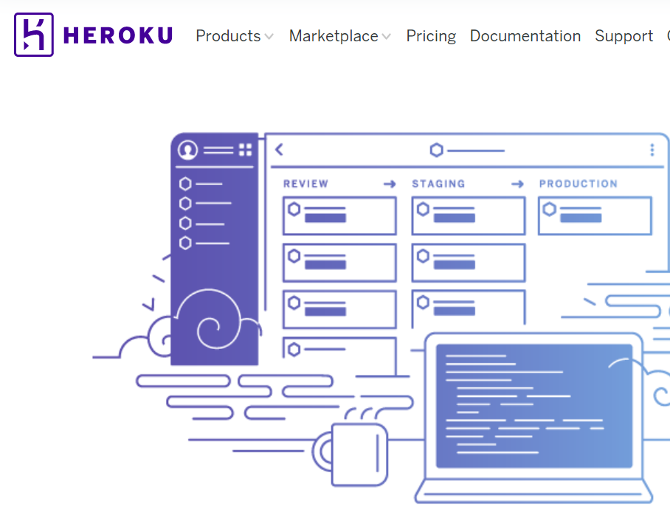
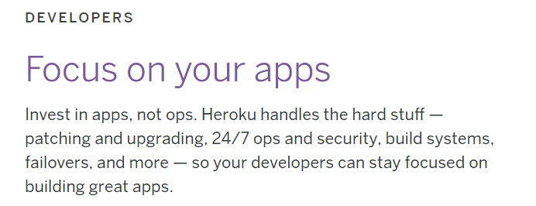
PaaS example, Heroku
Heroku is another example of PaaS.
This is for software developers.
Heroku manages all the operations while the customers concentrate just in application development.

Slide 19
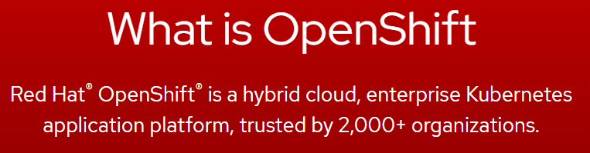
PaaS example, Red Hat OpenShift
Red Hat OpenShift
From Red Hat:
…”allows developers to focus on code and customers, not server and software configuration.”…
Again, the Platform is taken care of by the Cloud provider, in this case Red Hat does that.
The customer is an application developer.
Source: https://www.openshift.com/blog/what-is-platform-as-a-service-paas-2 (2020)

Slide 20
PaaS example, Google App Engine
Google App Engine is PaaS for developing and hosting web applications.
Google handles the infrastructure part.
The customer does not see any of that.
The customer does not even care about the underlay set up.
From Google:
…”Build Highly scalable applications on a fully managed serverless platform.”…
Focus on writing code without having to manage underlying infrastructure.
Pay as you go: …” Operate in a serverless environment without worrying about over or under provisioning. App Engine automatically scales depending on your app traffic and consumes resources only when your code is running”…
Source: https://cloud.google.com/appengine (2020)

Slide 21
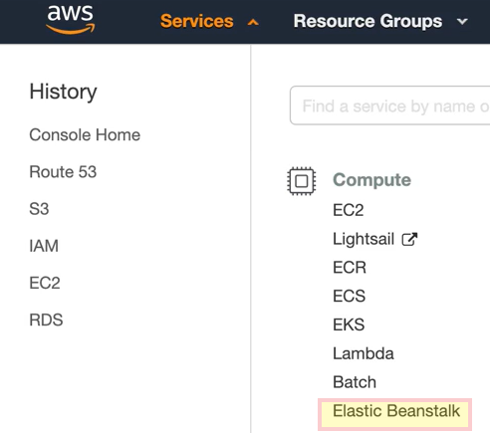
PaaS example, AWS Elastic Beanstalk
Definition from AWS website:
…” An Elastic Beanstalk application is a logical collection of Elastic Beanstalk components, including environments, versions, and environment configurations. In Elastic Beanstalk an application is conceptually similar to a folder.”…

Slide 22

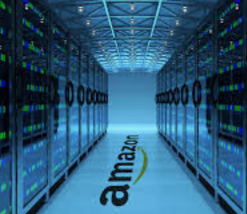
PaaS example, AWS Elastic Beanstalk
Amazon Web Services adopts several cloud models depending on the service (and AWS has many services).
One of AWS services is called Elastic Beanstalk.
AWS Elastic Beanstalk is a PaaS offering.
This is the use case; a customer provides a package with the files of a web project to AWS Elastic Beanstalk.
AWS Elastic Beanstalk takes care of placing API calls to provision all the resources needed to run the code.
Hence the name Beanstalk, it is almost like magic from the viewpoint of the customer.
Customer believe this
Platform provides everything else

Slide 23
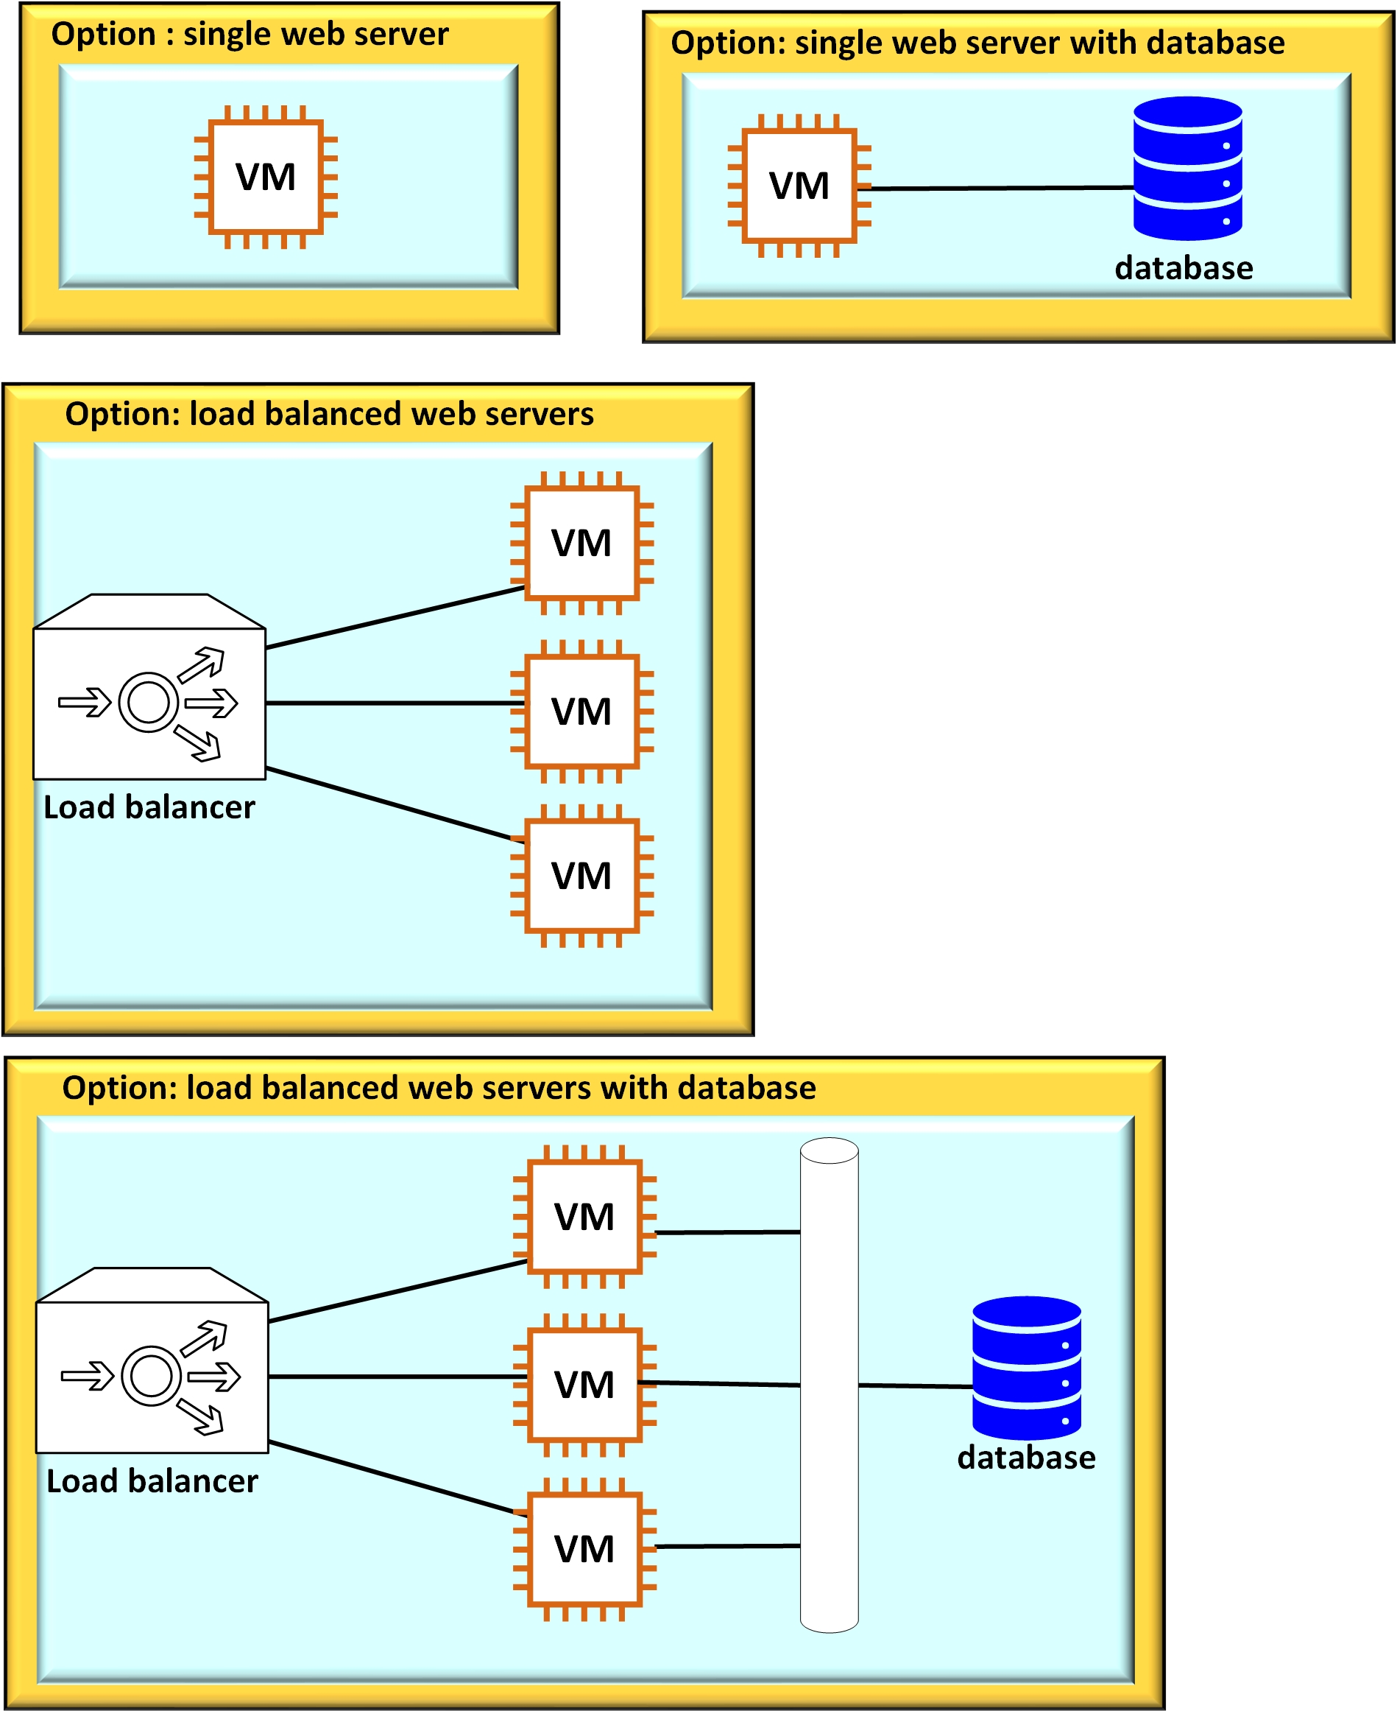
PaaS AWS Elastic Beanstalk
The figure shows four possible configurations that Elastic Beanstalk provisions.
The customer provides a ready-project in a zip file. (The code of the project).
Then, the customer chooses one of the four options shown here.
Elastic Beanstalk takes care of the provisioning of the webservers, firewalls and it makes the connections.
Note: Elastic Beanstalk does not provision the databases. That has to be done apart. However, Beanstalk makes the connections to the existing database.

Slide 24
PaaS example, Microsoft Azure
Azure also offers PaaS:
Azure App Service
Azure Cognitive Search
Azure CDN
From Azure:
...” Fully managed platform with built-in infrastructure maintenance, security patching, and scaling”…
Source: https://azure.microsoft.com/en-us/services/app-service/

Slide 25
Platform as a Service PaaS
It is easy to see why this model of Cloud service is attractive to application code developers.
Code developers just want to be productive in their code writing, they do not want to spend time dealing with infrastructure issues such as setting up servers on virtual machines, and uploading packages and licenses.
PaaS provides a ready to use platform via a developer interface.
The clients access (or consume) the end result via a web browser typically.

Slide 26
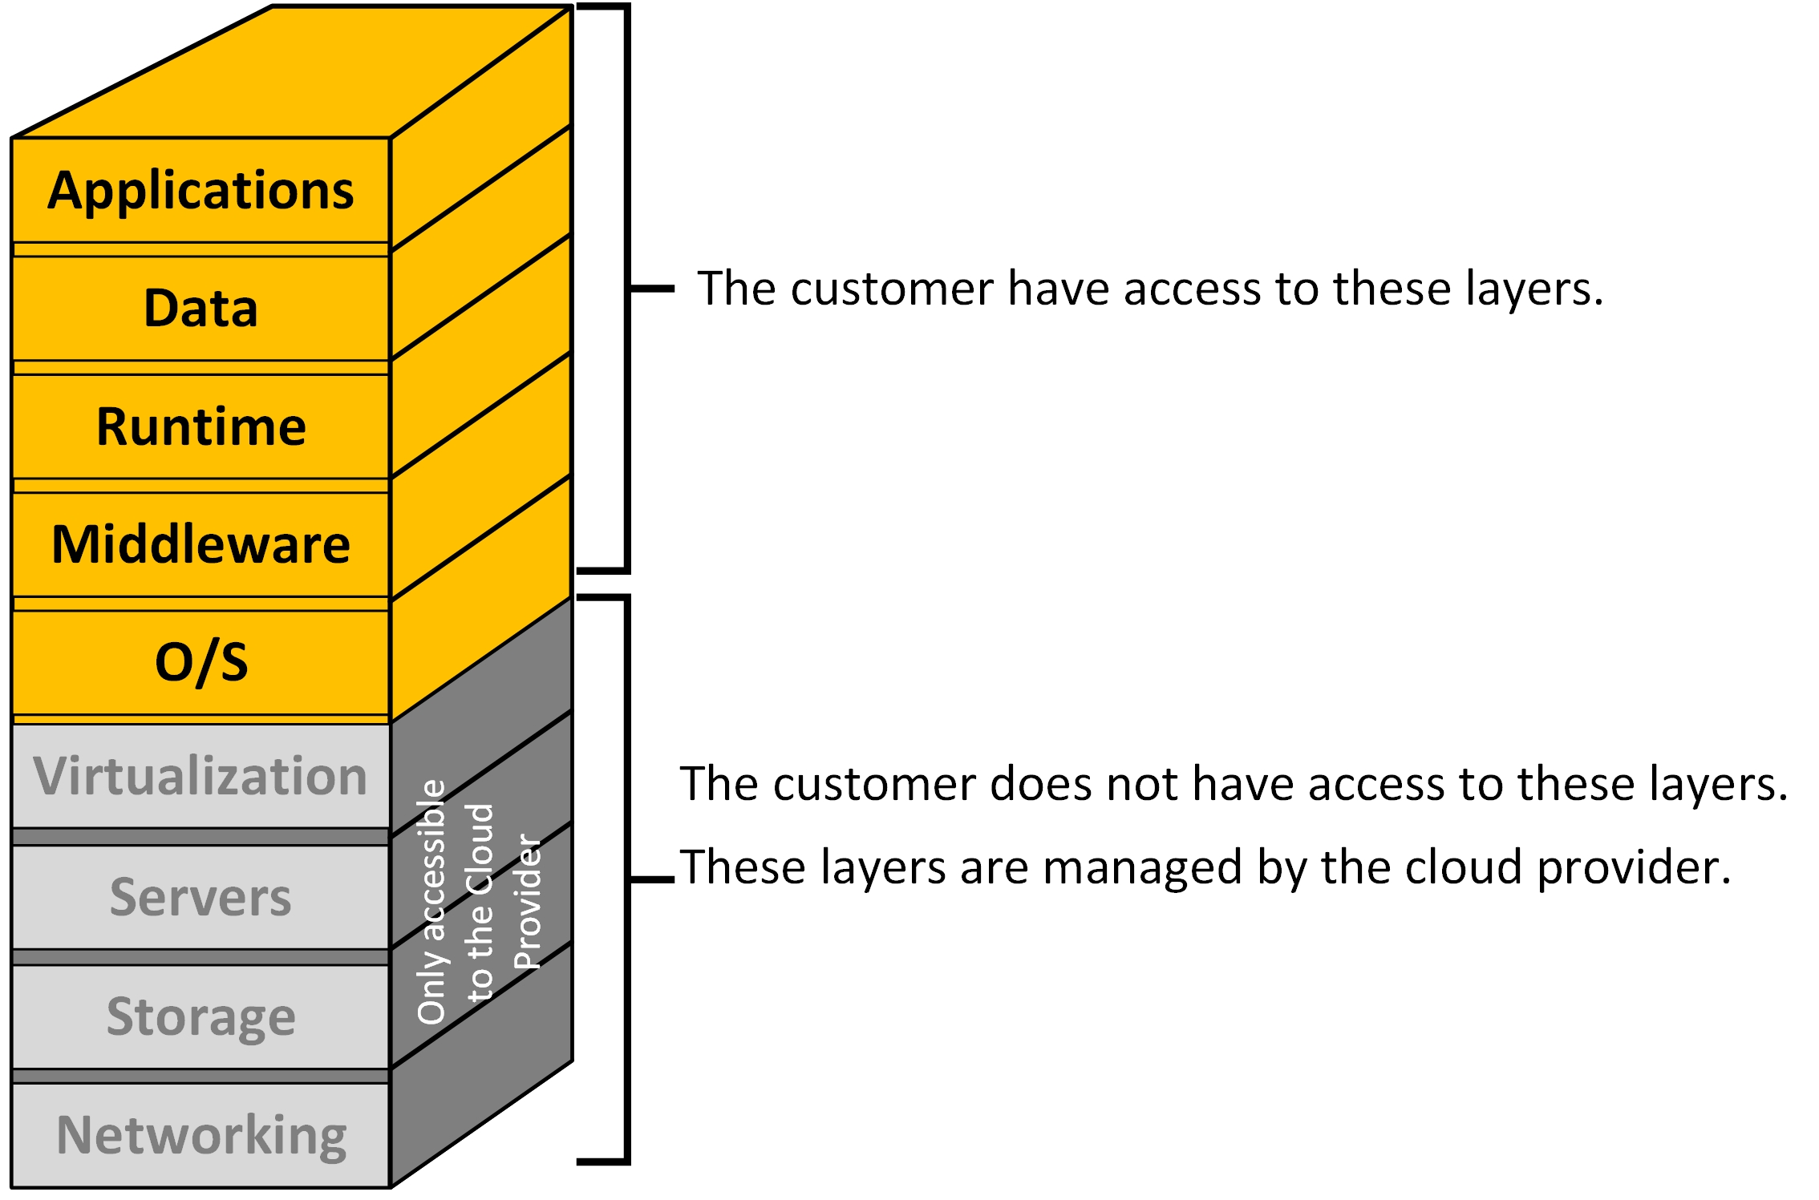
Infrastructure as a Service
IaaS

Slide 27
Infrastructure as a Service IaaS
IaaS is the virtualization of a computer network infrastructure inside a cloud datacenter.
IaaS are typically clusters of datacentres that present a configuration interface to the clients.
The customers deal with the interface and they can create and maintain their own virtual infrastructure.

Slide 28
Infrastructure as a Service IaaS
In the IaaS model, resources are deployed as virtualizations in the cloud datacentres.
These resources include computer-servers, networks, networking devices, security appliances, data storage systems and others.
So, what makes IaaS different to a on-premise datacenter?
Two keywords: Elasticity and On-demand.

Slide 29
Infrastructure as a Service IaaS
Situation: an organization is planning a new project.
Traditional approach:
Developers design the new application to be running on servers.
Accordingly, physical devices (servers, networking, etc) must be purchased and configured according to the estimated usage.
It takes months to purchase, deploy and configure these resources.
When the application is finally released for service, three things might happen:
a) the estimations of usage were correct
b) the demand for the service was underestimated so it becomes overloaded with the amount of service requests.
c) the service is not as popular as predicted so it is overprovisioned.

Slide 30
Infrastructure as a Service IaaS
If the application becomes overrun with requests, more resources need to be added.
That implies buying or leasing new servers, provisioning, licensing, etc. It will take time to satisfy the demand for the service.
By the time that the added capacity is provided, the service might have lost interest because of bad user experience.
If the application is underused, money is being wasted into the excessive equipment, scaling down is not feasible.

Slide 31
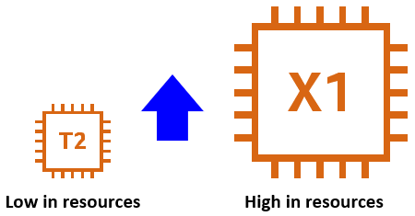
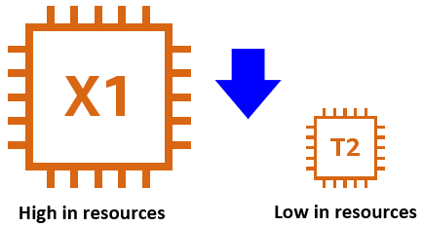
Definition
Vertical Scaling:
Scaling Up:
It is either adding more capacity (CPU, memory, storage) to an existing resource.
Or completely changing the instance type. For example, dynamically changing a server from Tiny to eXtra size.
Scaling Down:
Removing excessive capacity; for example, too much, unneeded storage.

Slide 32


Definition
Horizontal Scaling:
Scaling out:
More machines are added (as in a pool of resources) to share the processing of the workload.
Scaling in:
Resources are removed because they are not needed, or they are excessive.

Slide 33
Infrastructure as a Service IaaS
Two keywords: Elasticity and On-demand.
IaaS offers elasticity on demand.
That means if more resources are needed, the service can be scaled vertically or horizontally out dynamically.
If less resources is the solution, then the service can be scaled vertically down or horizontally in dynamically.
The cloud contains enough resources to provision any resource as soon as the customer request them (on demand for a price)
That is the great advantage of IaaS and the main difference with respect an on-premise datacenter.

Slide 34
IaaS
The figure shows the same four possible configurations that were shown with PaaS Elastic Beanstalk.
When the customer uses IaaS then every one of the components must be individually configured.
That implies that the customer must know how to deal with several services and place everything together.
For example, the Virtual Machines VM must be created and configured. The elastic load balancer must be created too and the connections among the components must be completed.

Slide 35
IaaS
IaaS offers a pliable model.
Customers can replicate their current on-prem infrastructure inside an IaaS cloud provider to migrate entirely.
Or in a mixed format, part of the on-prem DC is migrated to the IaaS cloud and part remains on-prem.
The two parts create a Hybrid model environment.

Slide 36


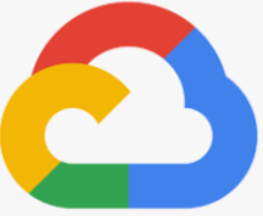


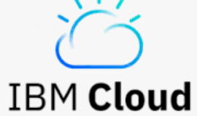

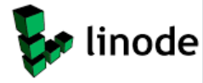
These are providers of IaaS:
Amazon Web Services AWS
Microsoft Azure
Google Compute Engine GPC
Digital Ocean
Oracle Cloud
IBM
Rackspace
Linode

Slide 37
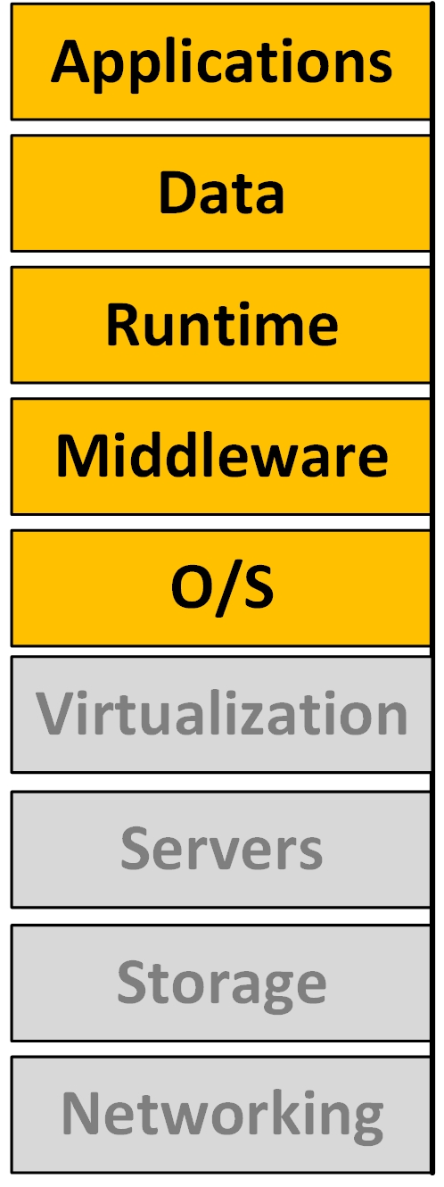
Infrastructure as a Service IaaS
The typical customer of IaaS must have a complete set of skill and knowledge to deal with every aspect of both Operations and Development.
IaaS requires the deployment of virtual resources on networks and the development of applications that run on those resources.
For example, an IT department, as a whole, will have such skill set.

Slide 38
Cloud layer model summary
Clouds are classified according to the level of access to the layers of this model.
The gray blocks indicate the layers that are beyond the reach of the client (or conversely what it is managed by the cloud provider).
The orange blocks represent the layers that the customer can directly work on.

Slide 39
Cloud Models
Cloud providers make available different service profiles to target different customer needs.
Consumers of completed cloud products gravitate toward Software as a Service clouds.
Software application developers naturally consume Platform as a Service.
Organizations that need to deploy complex structures use Infrastructure as a Service.
For mixed necessities, there is the Hybrid cloud model.

Slide 40
Reading
Sheridan College. CLOUD COMPUTING, A Strategy for Adoption, by James Duncan.
Purpose: likely, you will be making decisions about cloud adoption for an organization soon upon graduation.
Typically, you will start as a junior analyst or engineer, then scale up to senior positions so you will be making high level decisions.
This paper offers the view of what an organization must consider when contemplating moving services to the cloud.
Read it and answer the following questions (for discussion).

Slide 41
From reading
What are positive consequences of a successful cloud adoption strategies?
What are negative consequences of an unsuccessful cloud adoption strategies?
What is the difference between the Cloud First strategy with respect Cloud Only?
What is the cloud adoption strategy that the report recommends for Sheridan College?

Slide 42
From reading
Sheridan College has two datacenters (Mississauga and Trafalgar) supporting services such as:
Sheridan's website hosting.
DNS name resolution.
Databases.
Registrar Office Systems.
PeopleSoft (Human Resource systems, policies, academics systems).
Voice over IP.
Wi-Fi services.
Video network services (Sheridan TV)
Custom applications (video gaming, developer tools, etc).
When the College start moving services to the cloud, what services are more likely to go and what services are likely to stay in house?
Which ones would you say are the "good candidates to be migrated out to a cloud?
What about the people who work supporting those systems? What will their role be?

Slide 43
From Reading
What does "competitively selected Cloud Platform of Record" mean in the paper?
What are the characteristics of resources that can be successfully placed in the cloud?
What are the services that Sheridan already have in clouds and what is the cloud model used for that?
What are the benefits and disadvantages of?
On premise Enterprise IT application
IaaS
PaaS
SaaS

Slide 44
From reading
What is a risk for Sheridan College when faculties or research units choose "to go their path to provisioning and supporting cloud services”?
What is a goal, or at least a hope, of Sheridan College that cloud will bring about costs and budgeting?
How does a cloud contribute to achieve that goal?

Slide 45
From reading
From the paper:
..."The migration of on-premise infrastructure to public cloud, and the divestment of responsibility that entails for hardware and software infrastructure, will over time (after migration and automation capabilities have been leveraged) allow technical team members to refocus on activities that provide a higher degree of value to the organization"...
Like what?

Slide 46
From reading
The College plans to use as a principle: Optimize "Lift and Shift" Operations. If an application is inefficient, will moving it to the cloud bring any benefit? What is the plan for those applications?
How will the College protect "Continuity of Institutional Data?
What does the report consider with respect applications that are: a) near end-of-life cycle, b) recently contracted?

Slide 47
Reading
From the paper:
We have covered the concept of scaling vertically and horizontally.
In the Technical Criteria part of the report, what is the factor considered that applies this concept?
What are the shifts expected for the IT Roles? For:
a) System Admins.
b) dBase Admins
c) Developers
d) Finance/Assets Management

